Slide 1
Приложение 4 / Appendix 4
MSc Program
Portfolio Sold-Out Problem in Numbers
for DeFi Lending Protocols
Student: Waralak Pariwatphan
Research Advisor: Yury Yanovich
April, 2023
1/17

Slide 2




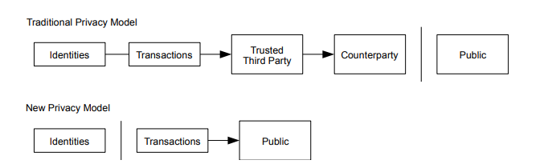
Background: DeFi Meets Classic Finance
Decentralized Finance: peer-to-peer financial services on public blockchains.
Lending protocols
Parameters:
Probability of default (PD)
Loss Given Default (LGD)
Liquidity coverage ratio
(LCR)
Bank secrecy
[Nakamoto, S. (2008). Bitcoin: A Peer-to-Peer Electronic Cash System. Www.Bitcoin.Org, 1–9. https://bitcoin.org/bitcoin.pdf]
The loan mechanism on the Maker protocol
2/17

Slide 3
Loan Portfolio Tokenization: Summary
Bank loans can be tokenized and regrouped into commodity
Lack of bank auditability by government
Free secondary market
New competitive tools for small investors
Free secondary market
Blockchain needed
3/17

Slide 4
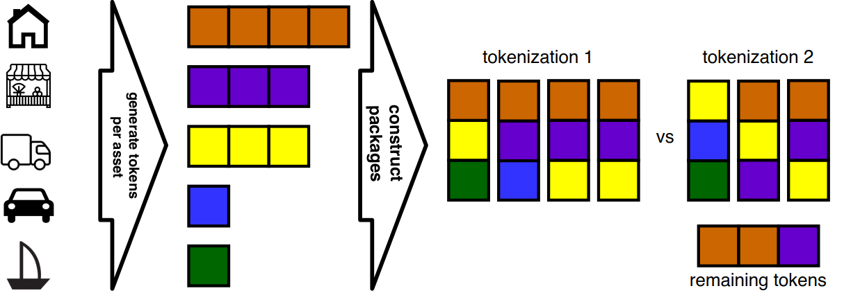
Portfolio Sold-Out: Problem
How to construct as many packages as possible for a given token set?
4/17

Slide 5
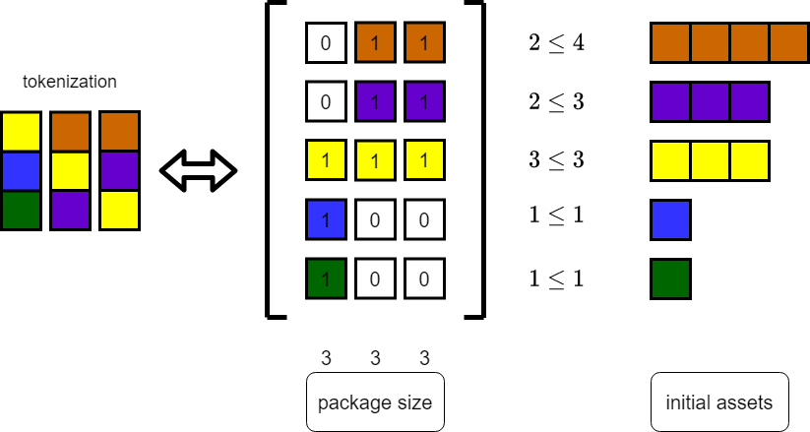
Portfolio Sold-Out: Objective
Find a matrix with the maximum possible number of columns
under given restriction.
5/17

Slide 6
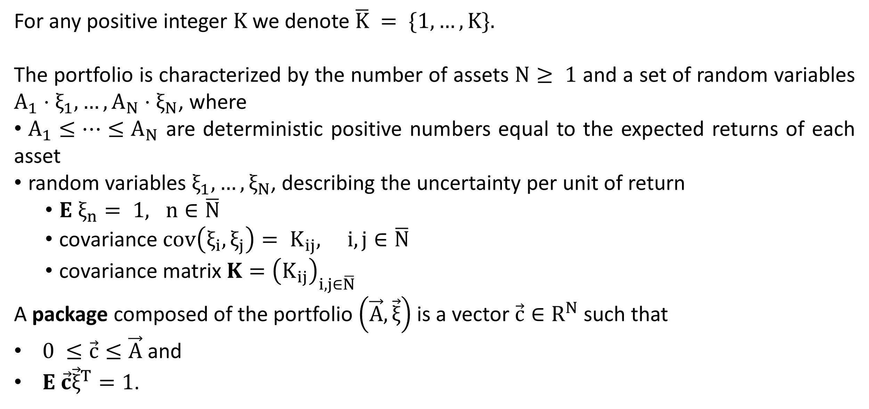
Portfolio Sold-Out: Notations
6/17

Slide 7
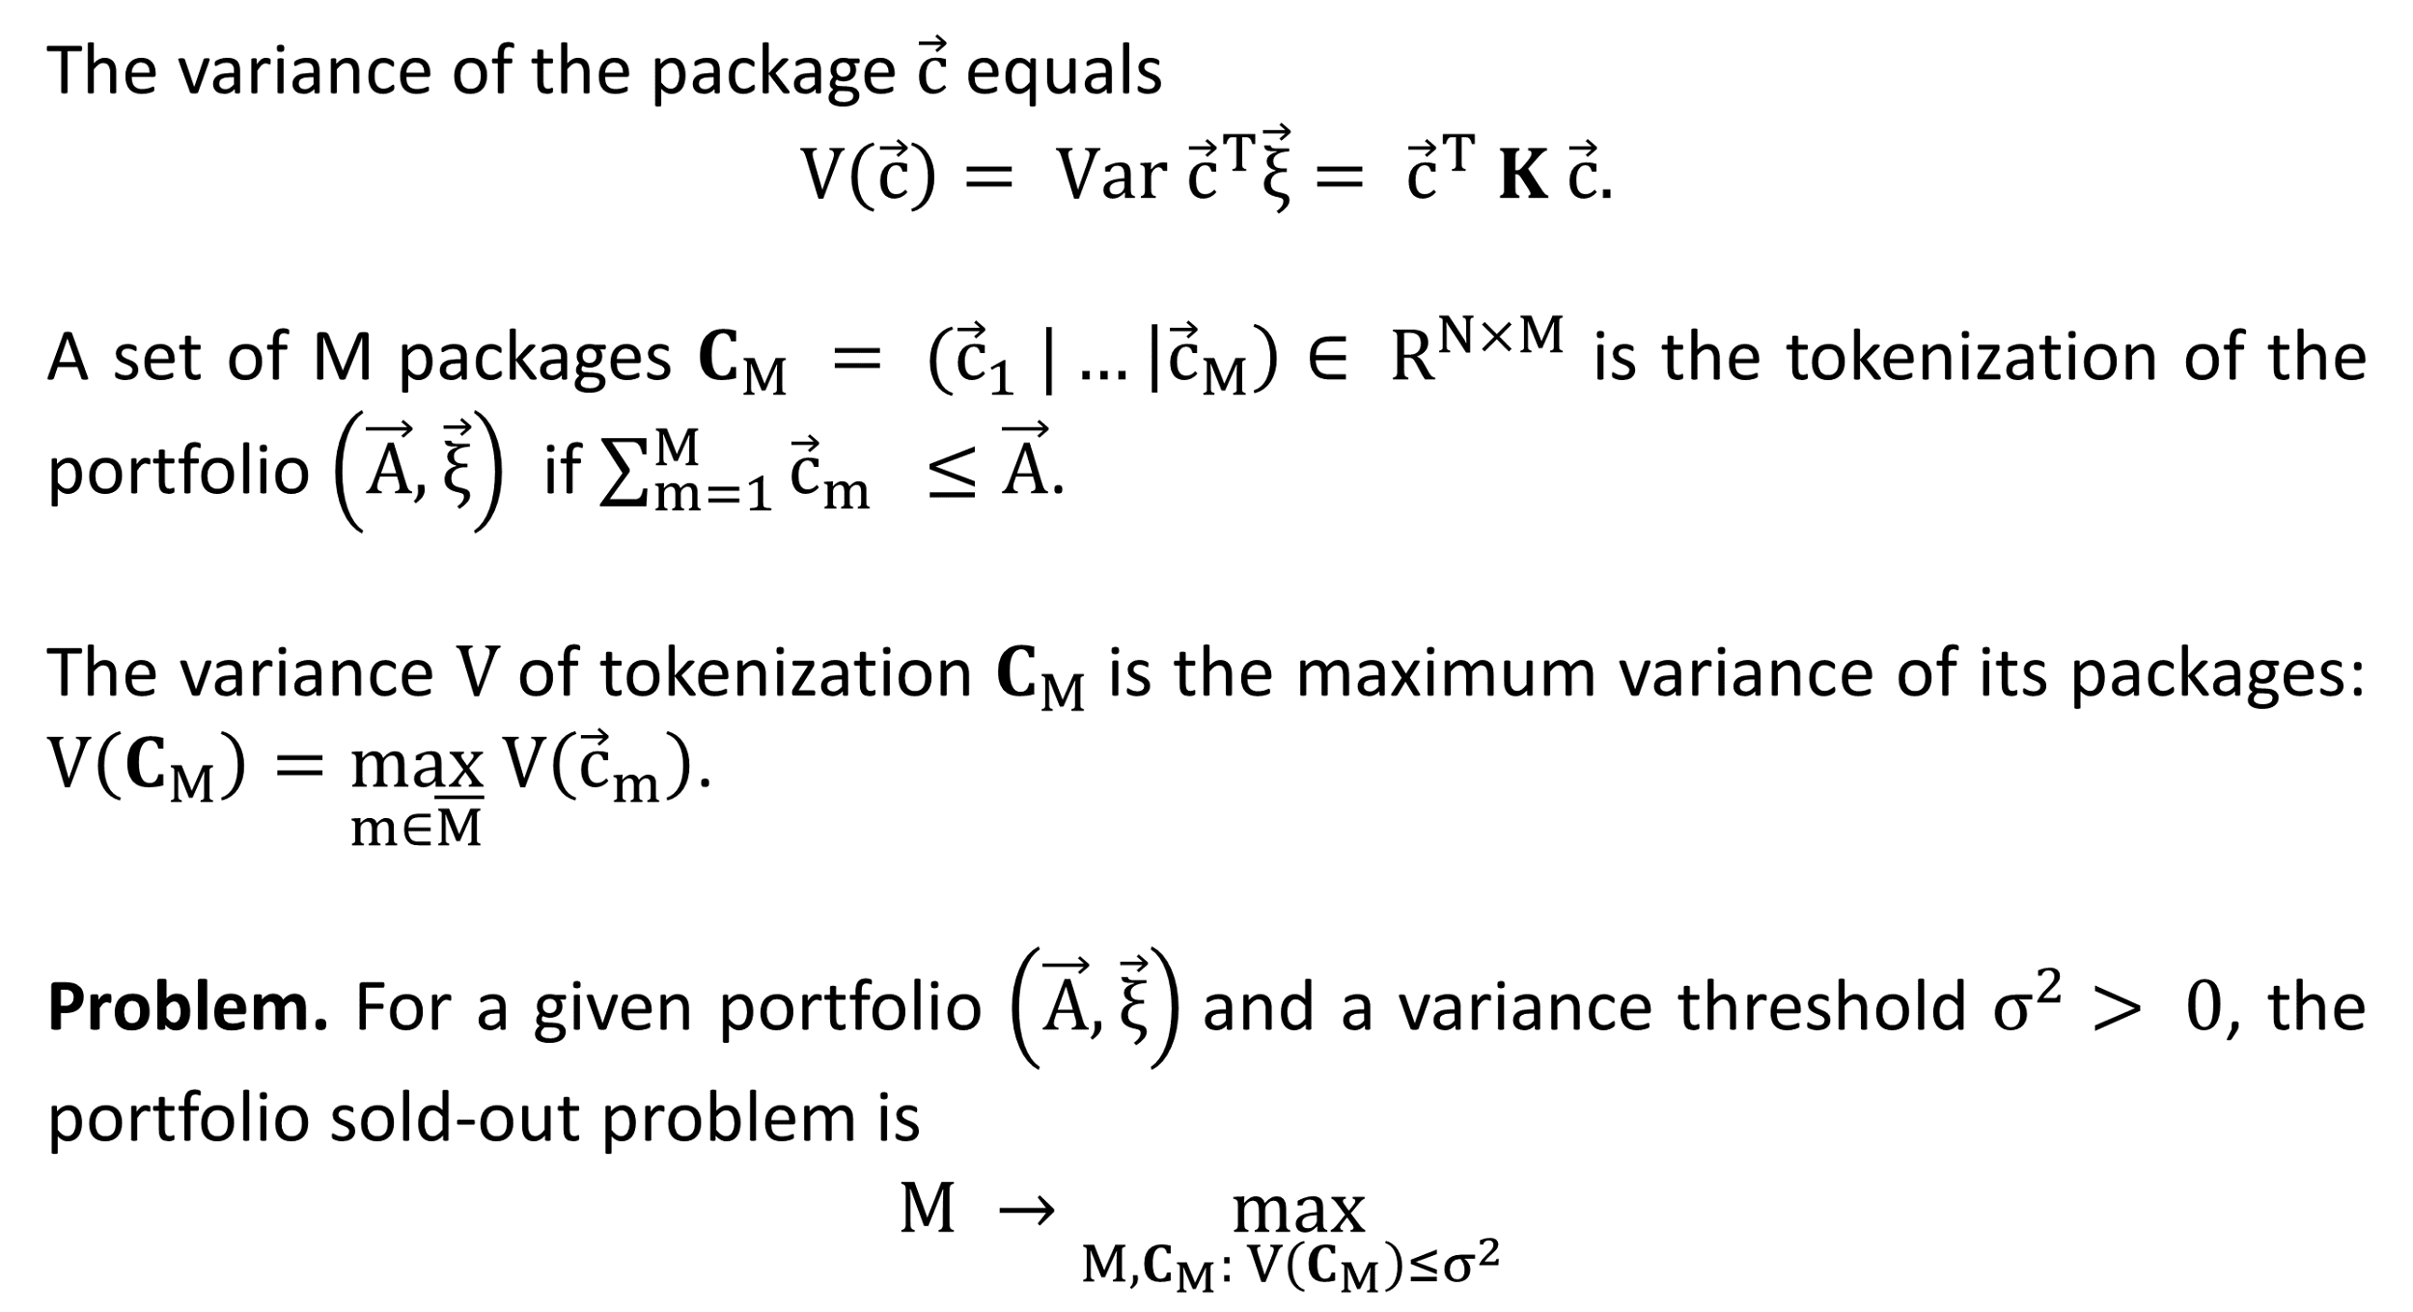
Portfolio Sold-Out: Problem
7/17

Slide 8
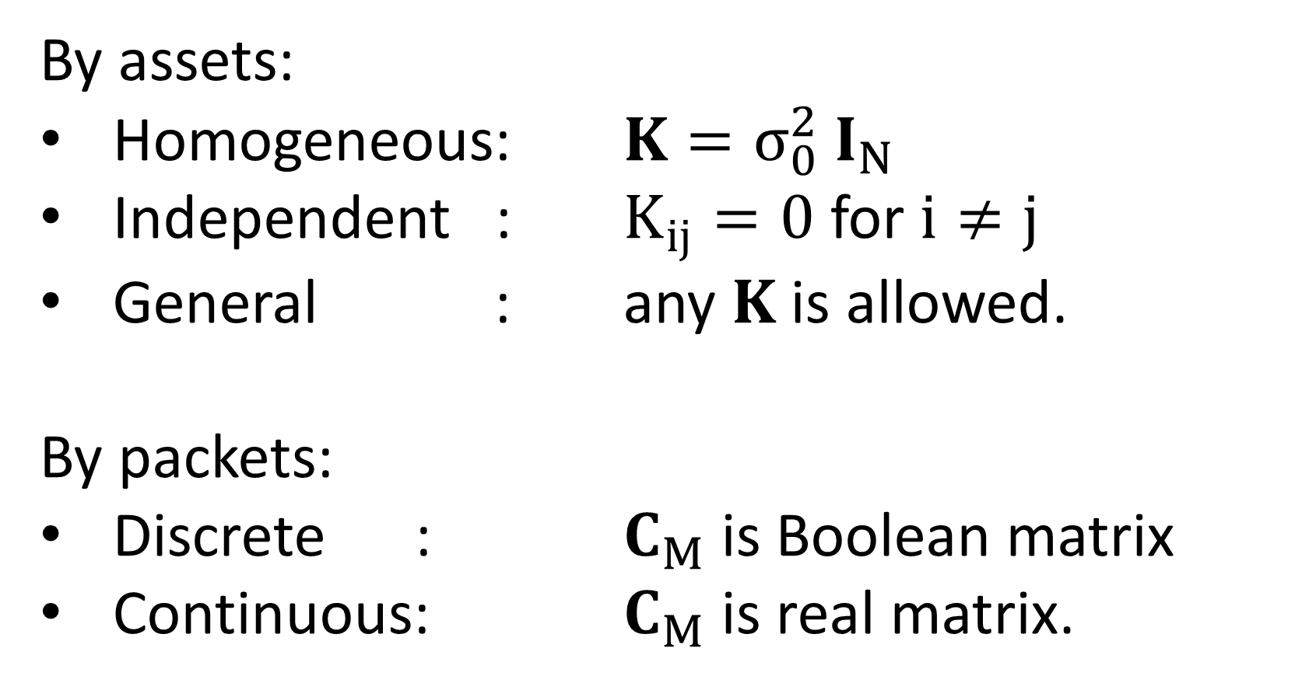
Portfolio Sold-Out: Special cases
 | Discrete | Continuous
Homogeneous | optimal solution | optimal solution
Independent | to be solved | to be solved
General | to be solved | numerical solution
8/17

Slide 9
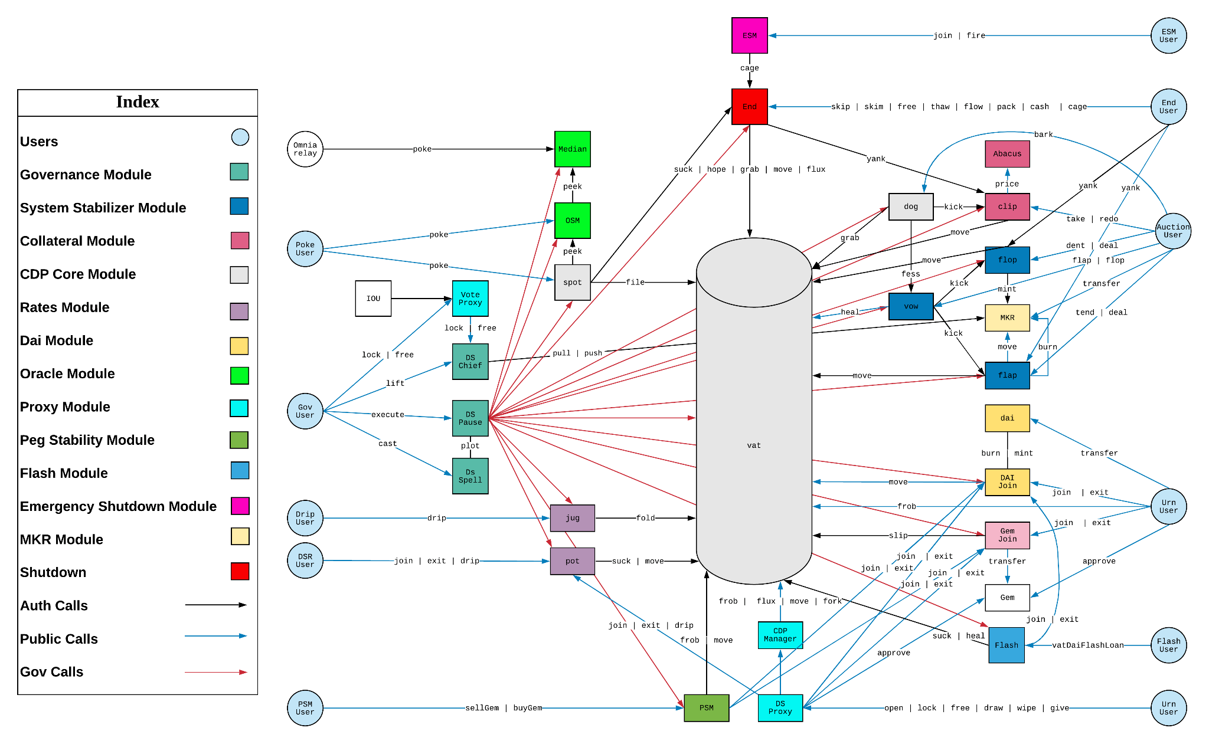
MakerDao
ilk.pip
holds the current price of a given ilk (collateral)
Vat
stores Vaults and tracks all the associated Dai and Collateral balances
Jug
accumulate stability fees for a particular collateral type
MakerDao Structure
9/17

Slide 10
Objectives
01
Design and develop optimization method to obtain the optimal portfolio sold-out
02
Apply optimization method to the MakerDao dataset
10/17
Notes:
The overall purpose of the work is to …
The objectives of the present research run as follows:
1…
2…
3…
Design and develop optimization method to obtain the optimal portfolio sold-out
2. Apply optimization method to the MakerDao dataset

Slide 11
Methods
Reduce portfolio sold-out to Second-Order Cone Programming (SOCP)
Prepare MakerDao dataset for tokenization
Apply SOCP solver to portfolio sold-out problem
11/17

Slide 12
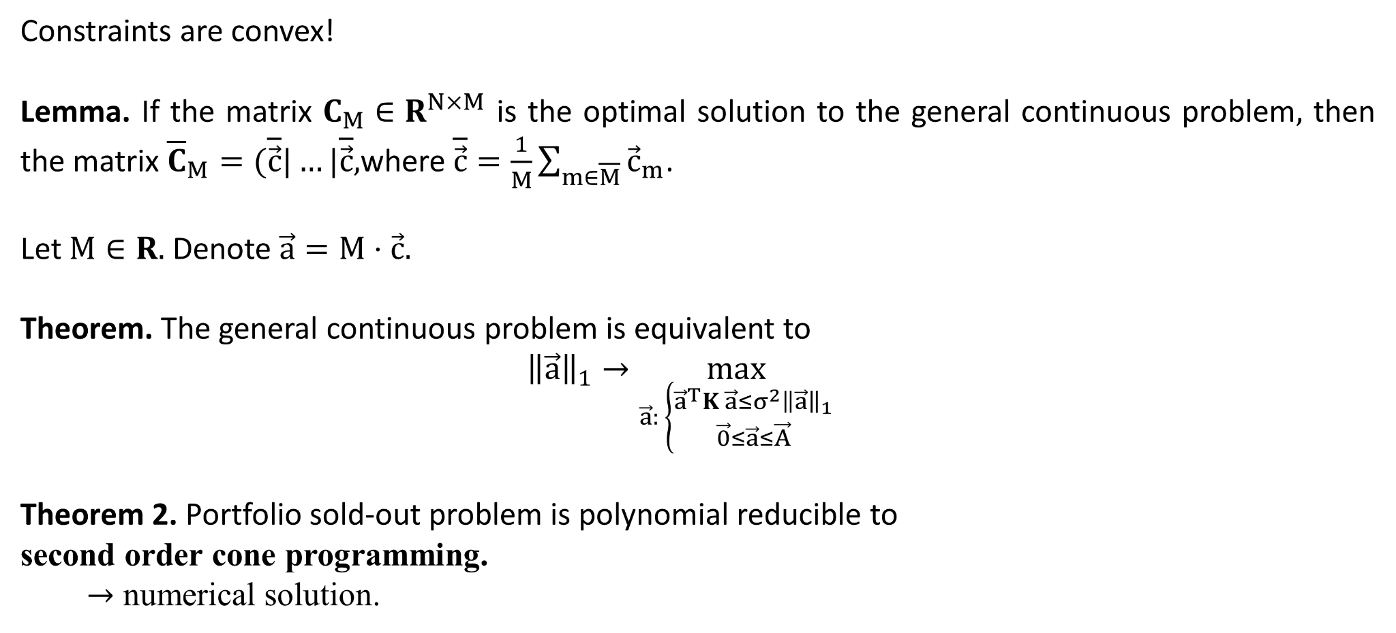
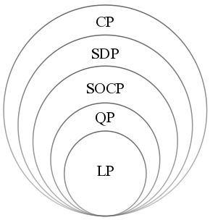
Results: General Continuous
LP: linear program,
QP: quadratic program,
SOCP second-order cone program,
SDP: semidefinite program,
CP: cone program.
12/17

Slide 13
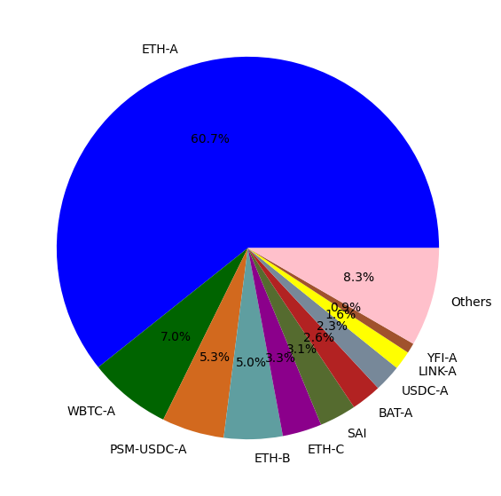
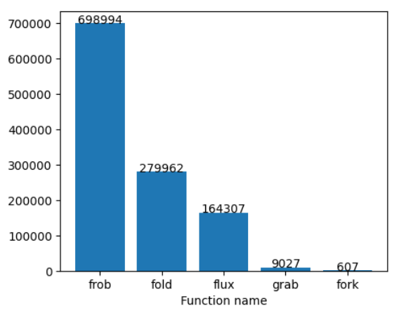
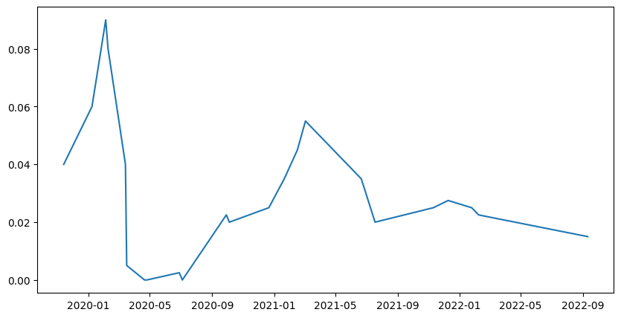
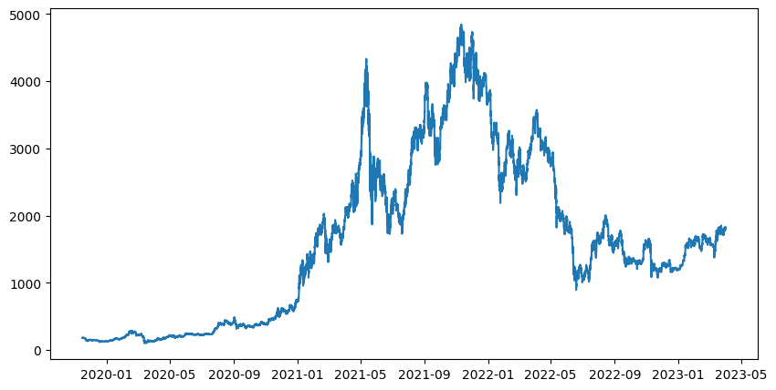
Results: MakerDao Data
Figure 1: Total number of each function name
Figure 2: Proportion of each collateral type
13/17
Figure 3: Stability fee rate per year
Figure 4: ETH/DAI rate

Slide 14
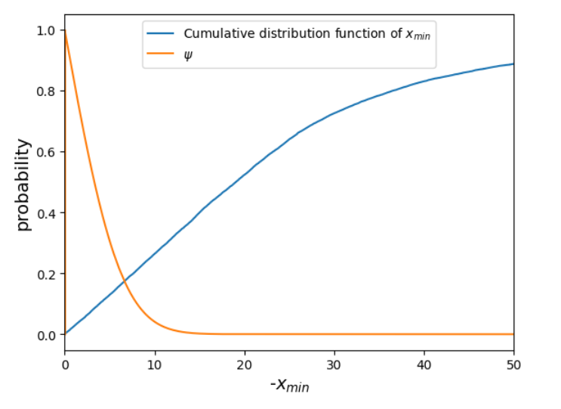

Results: MakerDao for Portfolio Sold-Out
Daily data
A is borrowers with debt amounts.
K is a covariance for their defaults.
Figure 5: Probability and level of default
14/17

Slide 15
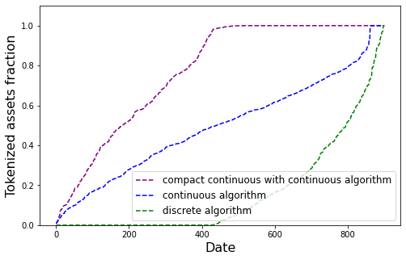
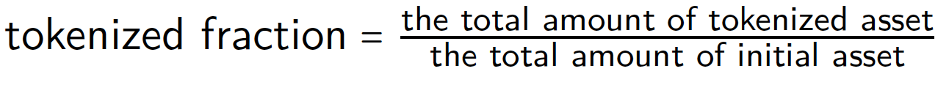
Baseline: MakerDAO dataset
The proportion of tokenized asset into the packages defines as
Table: The tokenized fractions of different models
Method | Tokenized fraction
Compact continuous with continuous algorithm * | 76.58 %
Special case continuous algorithm ** | 40.01 %
Special case discrete algorithm ** | 13.65 %
* Solved by the metaheuristics Slime Mould Algorithm (SMA)
** Mis-Model assumption: independent with the same variance.
Figure 6: Tokenized into commodity asset fractions
15/17
Notes:
The compact continuous with continuous algorithm, 77% of initial assets are tokenized and allocated into packages which is the highest tokenized fraction. Following by continuous and discrete algorithm.

Slide 16
Conclusions
Portfolio sold-out problem is reduced to SOCP, which allows optimal numerical solution.
MakerDao DeFi protocol provides real loan dataset, which is impossible for classic banking system.
SOCP solver will be applied to the MakerDao dataset
16/17
Notes:
Phrases you may find useful:
All these results suggest that …
We can conclude that …
Taken together, these results point to three conclusions …
To sum up, …
Although it is still too early to draw a definite conclusion, it can be stated that …
Although the obtained data are limited, we may conclude that

Slide 17
Outlook: Planning to Achieve
To complete optimization part with solving SOCP.
17/17
Notes:
Phrases you may find useful:
The achieved results indicate that the work along the same line should proceed. Thus, the long-term results of the project are to …

